Slide 1

STANLEY COLLEGE OF ENGINEERING AND TECHNOLGY FOR WOMEN
(AUTONOMOUS), Abids. Hyderabad - 500 001
(Affiliated to Osmania University & Approved by AICTE)
(All eligible UG Courses are accredited by NBA & Accredited by NAAC with 'A' Grade)
Department of CSE B.E in Computer Science and Engineering
Academic Year: 2024-2025
Title : Counting Number of Boxes in a Warehouse using Computer Vision
PRESENTED BY Praneethanjanee Karanam (160622733092)
Under the Guidance of B. Soujanya Assistant Professor And M. Sara Angeline Assistant Professor
Department of Computer Science and Engineering

Slide 2
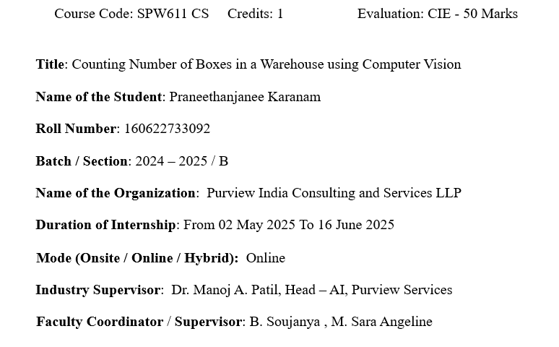
Internship Details

Slide 3
Contents
Problem Statement
Background and Literature / Technology Review
Planning and Design of Work
Implementation and Execution
Testing and Validation
Results and Analysis
Challenges and Solutions
Conclusion and Future Scope
References
Internship Certificates

Slide 4
Problem Statement
Manual counting of boxes in warehouses is time-consuming and error-prone.
Errors lead to stock mismatches, delays, and financial losses.
Goal: Develop an automated box counting system using Computer Vision.
System should:
Detect and count boxes from real-time video/images.
Reduce manual intervention.
Improve inventory accuracy and efficiency.
Supports Purview’s goal of AI-driven industrial automation.

Slide 5
Background and Literature Review
No. | Paper / Source | Key Contribution / Finding | Relevance to Project
1 | YOLO: Unified Real-Time Object Detection (Redmon et al., 2016) | Introduced single-shot real-time object detection. | Foundation for real-time detection approach.
2 | YOLOv8 Technical Docs (Jocher, Ultralytics, 2023) | Enhanced speed & accuracy via anchor-free detection. | Guided model selection & training process.
3 | Faster R-CNN (Ren et al., 2015) | Proposed Region Proposal Networks for high-precision detection. | Compared for accuracy; slower than YOLO.
4 | EfficientDet (Tan et al., 2019) | Used compound scaling for efficiency–accuracy trade-off. | Tested baseline; weaker in dense environments.
5 | Detectron2 Framework (Facebook AI, 2021) | Modular framework supporting multiple detectors. | Used for architecture benchmarking.
6 | Deep Learning for Warehouse Automation (Zhang et al., 2020) | Survey on AI in warehouse automation. | Supported industrial relevance of our work.
7 | YOLOv5 in Industrial Automation (Ahmed et al., 2021) | Demonstrated real-time counting in production lines. | Provided YOLO-based comparative insights.
8 | Comparative Study of Object Detection Algorithms (Patel & Shah, 2022) | Compared YOLO, SSD, R-CNN for industrial tasks. | Validated YOLOv8 suitability for cluttered setups.
9 | Computer Vision in Logistics Management (Singh et al., 2021) | Applied CV to automate inventory verification. | Reinforced CV use for real-time inventory.
10 | Automated Counting using Deep CNNs (Kumar & Das, 2022) | Implemented CNNs for package detection & counting. | Inspired design of deep-learning counting logic.

Slide 6
Technology Review
Technology / Tool | Purpose / Use
Python 3.x | Core programming language
YOLOv8 (Ultralytics) | Real-time object detection
OpenCV | Image and video processing
PyTorch | Deep learning framework
Tkinter | GUI development
PIL (Pillow) | Image conversion for GUI display
Webcam | Live video input

Slide 7
Planning and Design of Work
Internship Plan & Timeline
Duration: 6 Weeks (May–June 2025)
Week-wise Plan:
Week 1: Problem study, research, tool setup
Week 2: Dataset collection & annotation
Week 3: Model exploration (YOLOv8–11, RetinaNet)
Week 4: YOLOv8 training & tuning
Week 5: GUI integration using Tkinter
Week 6: Testing, documentation & presentation preparation

Slide 8
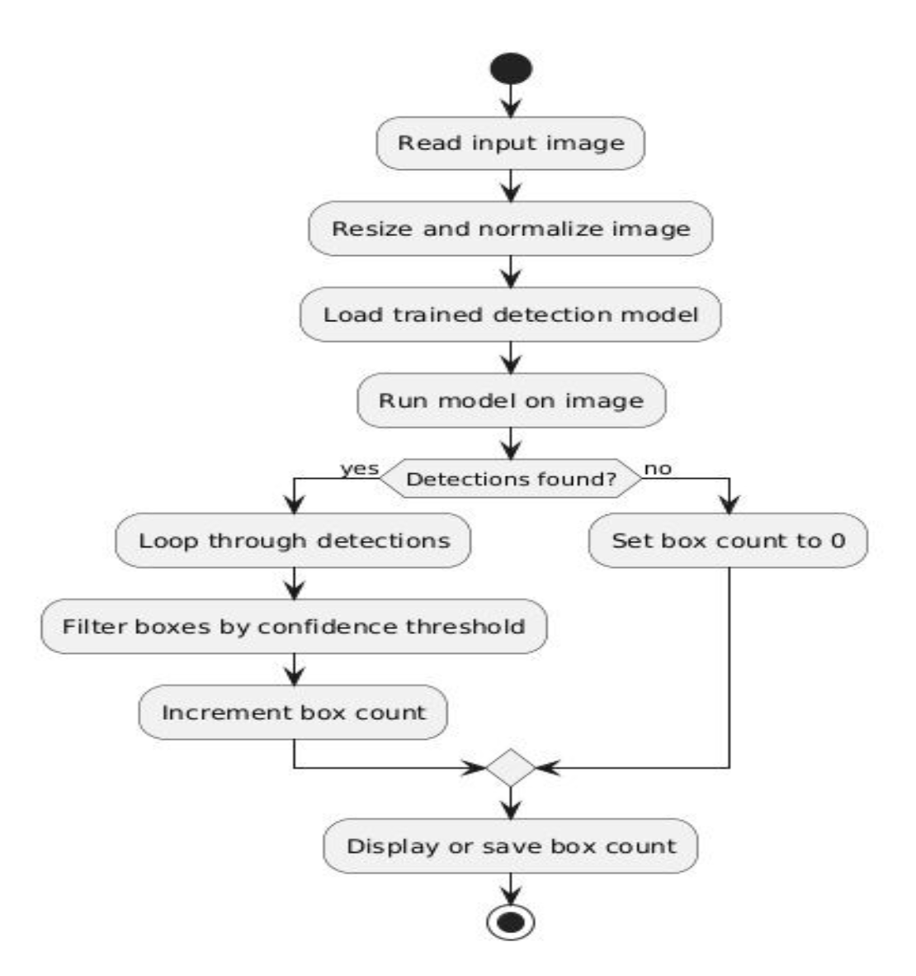
Planning and Design of Work
Workflow of the System
Sequence of Development Phases:
Data Collection → captured warehouse images
Annotation → manual bounding boxes for YOLO format
Model Training & Tuning → YOLOv8 fine-tuning
Testing & Validation → evaluate precision, recall, mAP
GUI Integration → connect model with Tkinter interface
Result Visualization & Analysis → display counts + save outputs

Slide 9
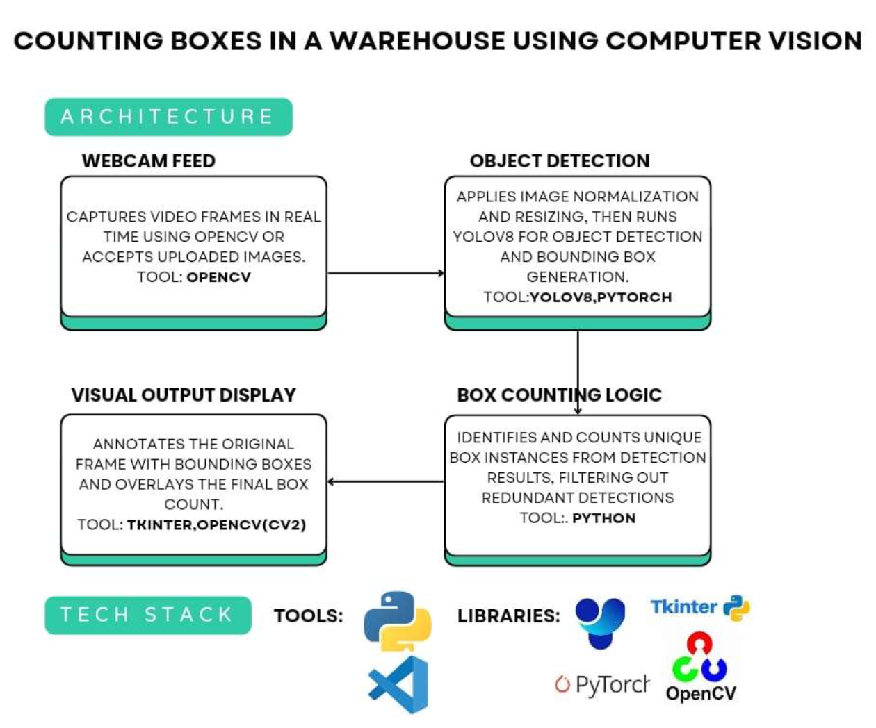
System Architecture
Modules:
Input (webcam/image upload)
Preprocessing
Detection (YOLOv8)
Counting
Output Visualization

Slide 10
Implementation and Execution
Developed a real-time box-counting system using Python, OpenCV, PyTorch, and Tkinter
Selected YOLOv8 after comparing YOLOv11, RetinaNet, Faster R-CNN, EfficientDet-D0, and Tiny YOLOv3
Prepared a custom dataset of 1049 warehouse images (80% train / 20% val) with manual annotations
Integrated modules: Camera Capture → YOLO Detection → GUI Output
GUI supports image upload, webcam live detection, and result display

Slide 11
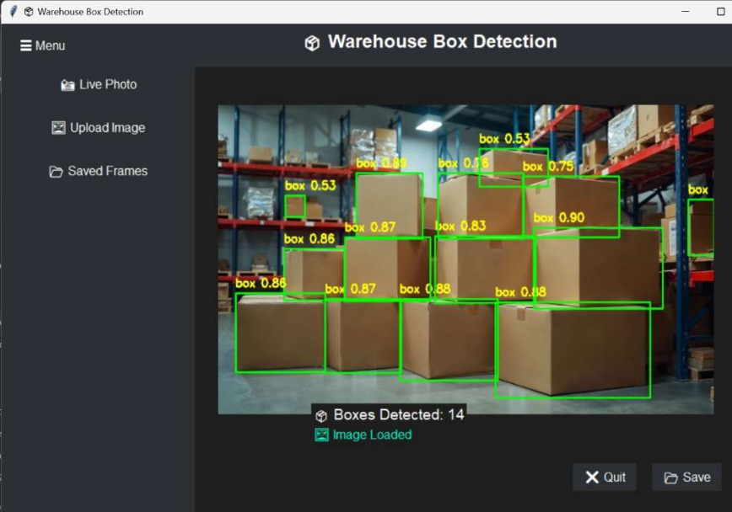
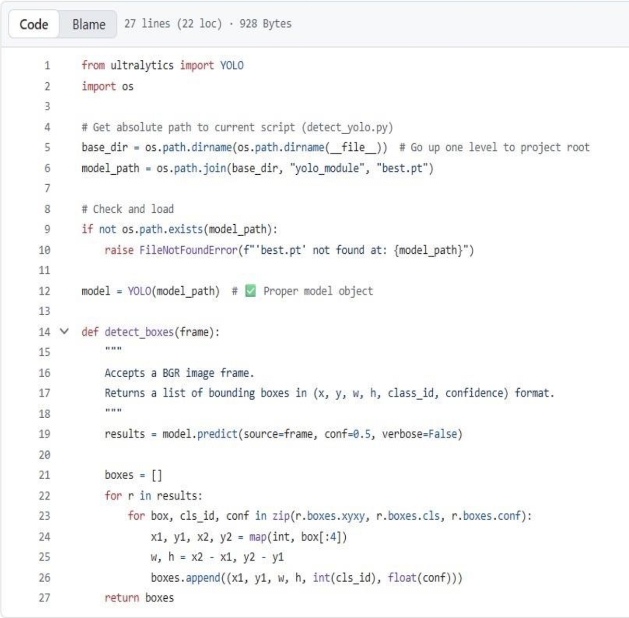
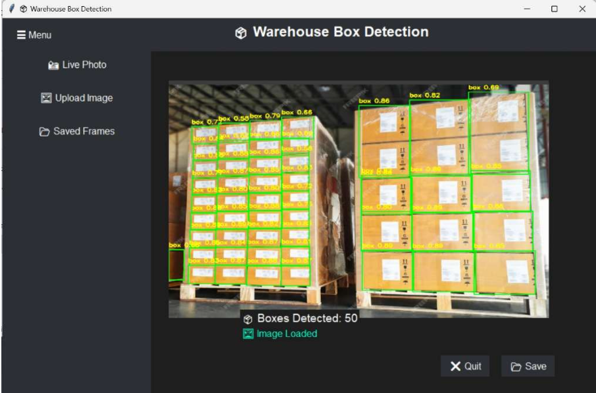
Results
Pseudocode

Slide 12
Testing and Validation
Performed unit testing on image capture, YOLO detection, and GUI modules
Conducted integration testing for full pipeline: Camera → Detection → GUI
Tested system under different lighting, angles, overlaps, clutter
Validated model using Precision, Recall, mAP@0.5, mAP@0.5:0.95
Real-time testing with live webcam feed to check FPS + latency
GUI tested for usability, responsiveness, error handling
Issues fixed: low-light detection errors, CPU-based lag, threshold tuning
Final system achieves stable real-time performance + high accuracy

Slide 13
Results and Analysis
The system produced stable outputs across all test cases.
Initial observations showed performance differences between the models.
One model demonstrated faster execution, while another showed higher accuracy.
Variations in efficiency and error rates were noted during testing.

Slide 14
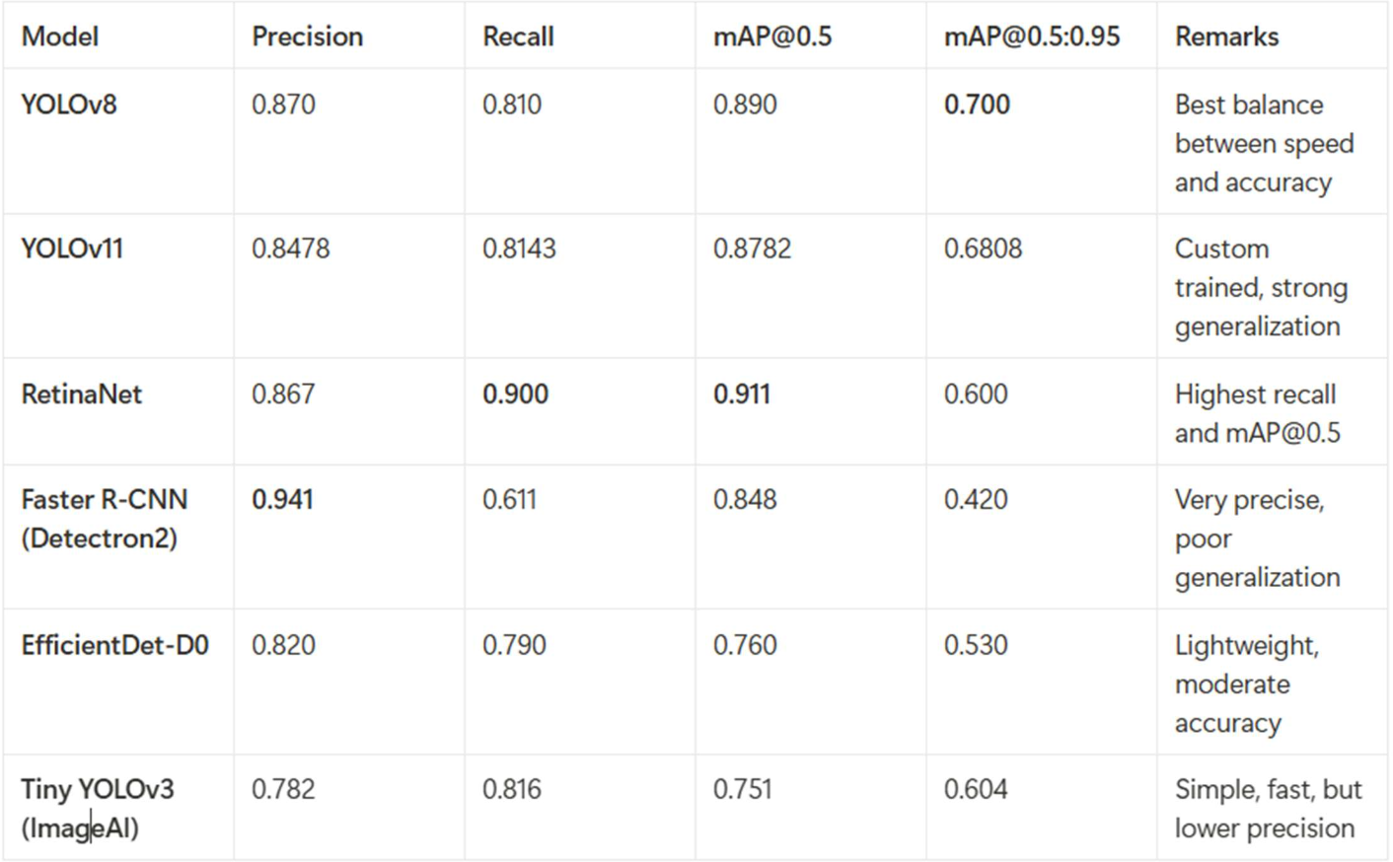

Slide 15
Challenges and Solutions
1. Poor Dataset Quality Solution: Re-annotated images properly and collected clearer, diverse samples.
2. Model Not Detecting Correctly on New Images Solution: Added more varied training data and improved training settings.
3. Detection Errors in Cluttered/Overlapping Boxes Solution: Trained with tougher images and adjusted settings to separate overlapping boxes better.
4. GUI Not Displaying Results Properly Solution: Fixed image format conversions and improved how frames load in the interface.

Slide 16
Conclusion
The system can detect and count boxes accurately in real time.
YOLOv8 gave the most reliable results overall.
The model works well across different warehouse images.
The final solution is fast, stable, and easy to use.

Slide 17
Future Scope
Add multi-class detection for different box types/sizes.
Integrate barcode/QR scanning for inventory automation.
Deploy on edge devices (like Raspberry Pi) for on-site use.
Improve accuracy using larger datasets and augmentation.

Slide 18
References
Redmon, J. et al. (2016). YOLO: Real-Time Object Detection.
Ren, S. et al. (2015). Faster R-CNN.
Tan, M. et al. (2019). EfficientDet.
Ultralytics (2023). YOLOv8 Documentation.
Facebook AI Research (2021). Detectron2 Framework.
Bradski, G. (2000). OpenCV Library.

Slide 19
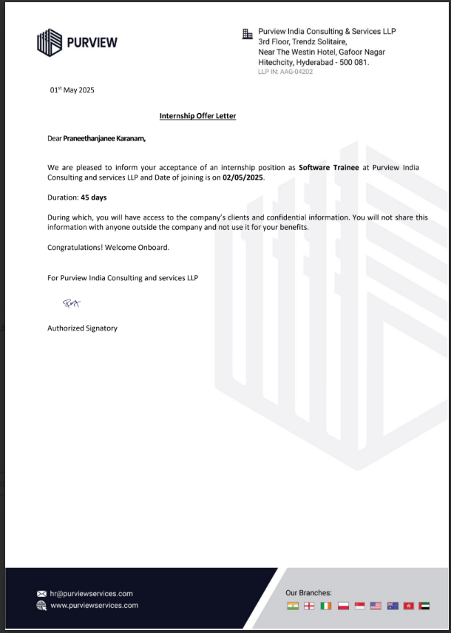
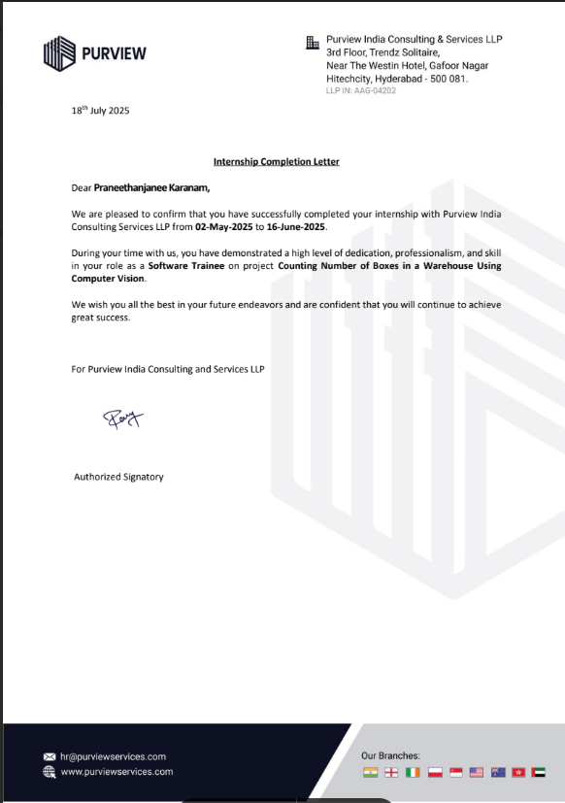
Internship Certificates

